Slide 1


Smash Tourni Application
Team – 24
Preetham Reddy Boddu
1002030625
Prudhvi Gudipati
1002032517

Slide 2
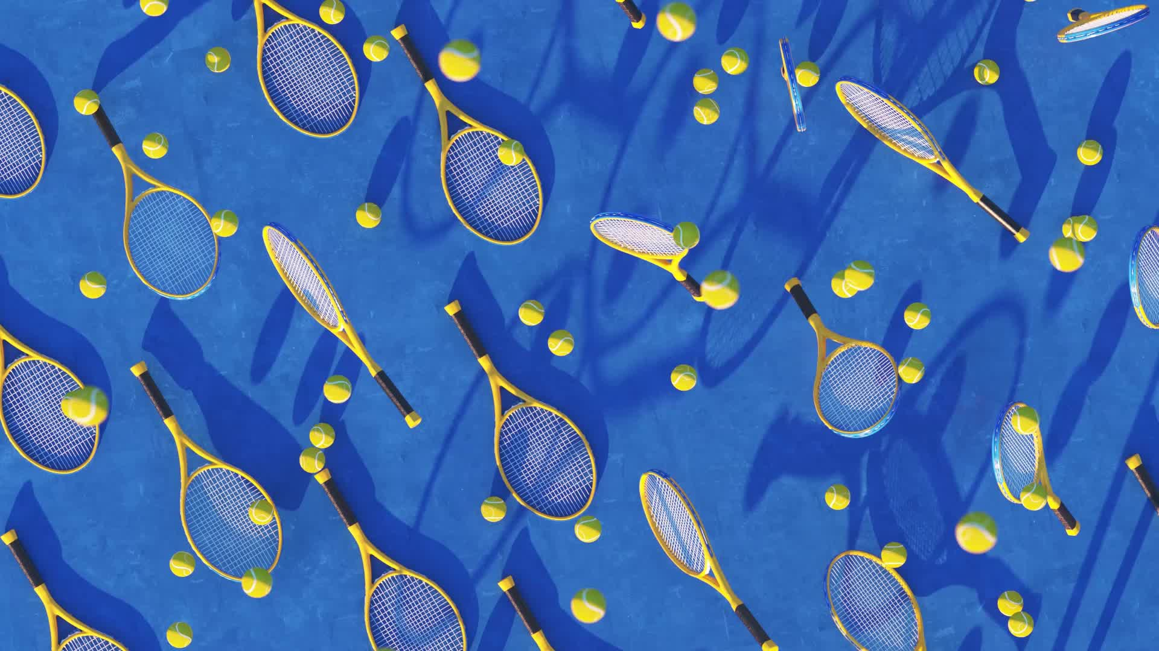
Introduction
Smash Tourni is a comprehensive solution designed to simplify and streamline the management of player registrations and payments for a diverse range of tournaments, including sporting events and gaming competitions. The primary objective is to enhance the efficiency of the entire tournament organization process.

Slide 3
Requirements
Functional Requirements:
User Registration
Event Customization
Participant Management
Communication Tools
User Authentication
Non-Functional Requirements:
Performance
Security
Scalability

Slide 4
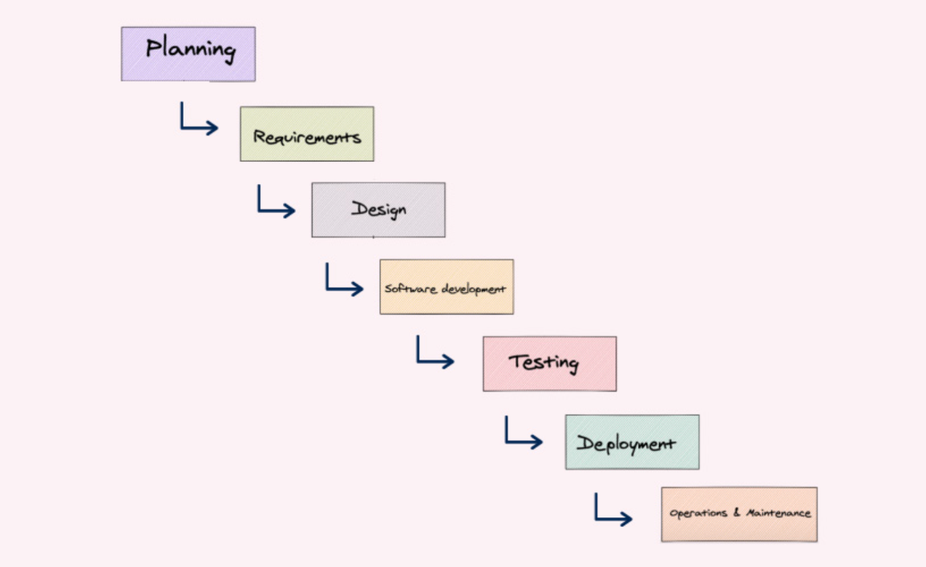
SDLC Model
Waterfall model:
Opted this because we have well defined requirements. Its effectively works for limited people.

Slide 5
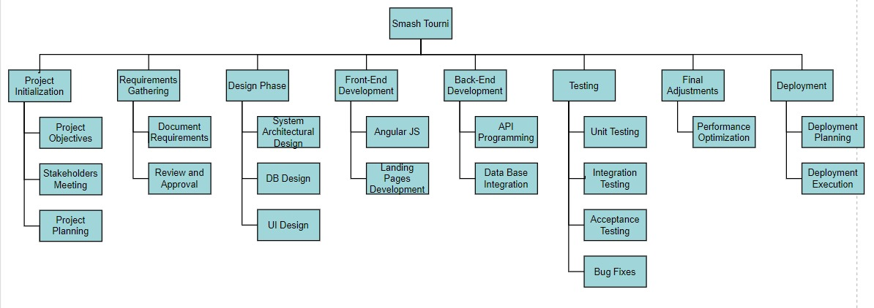
Work breakdown Structure

Slide 6
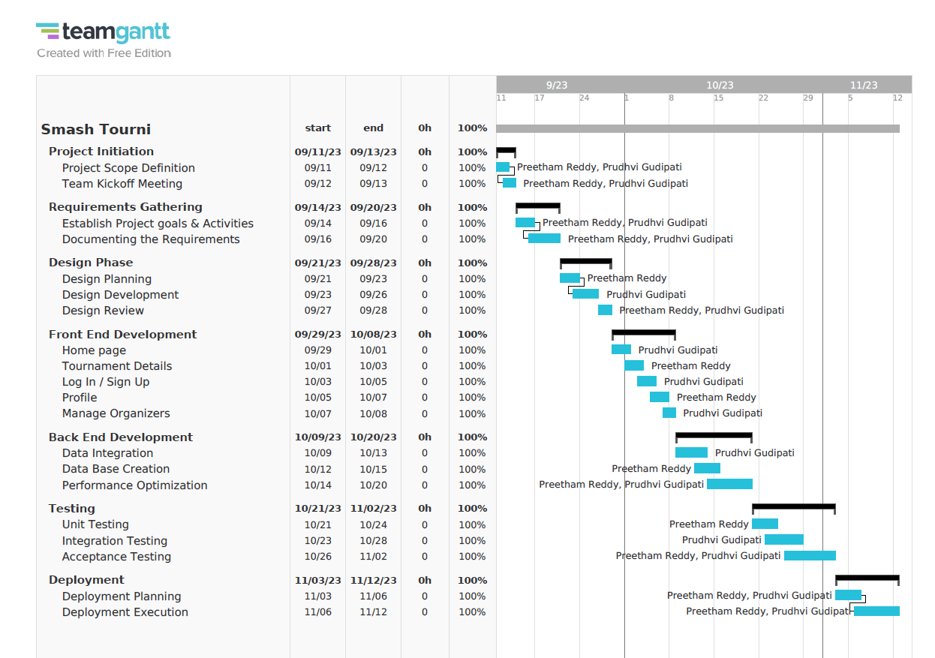
Project Planning and Roles

Slide 7
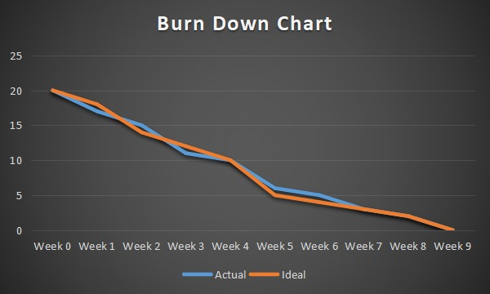
Burndown Chart

Slide 8
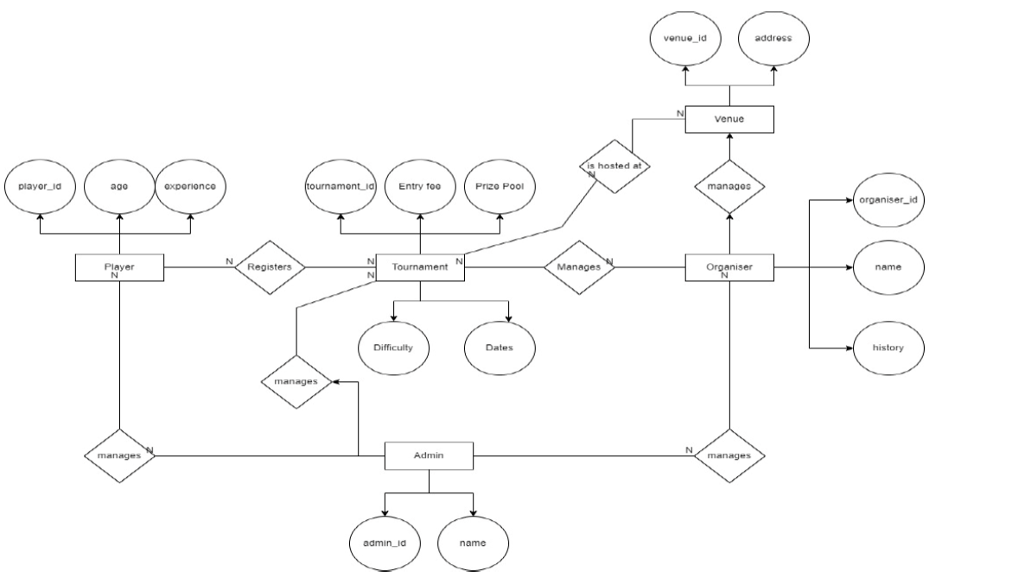
ER Diagram

Slide 9
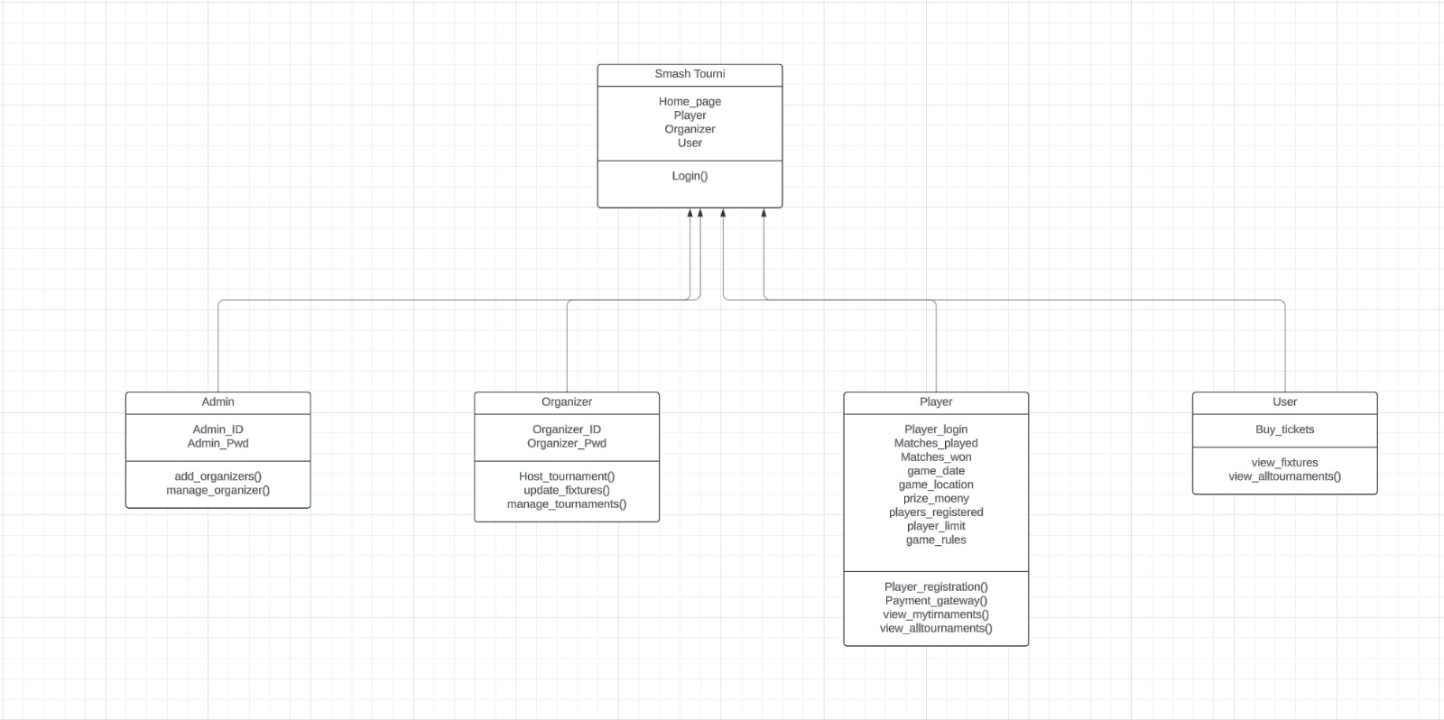
UML Diagram

Slide 10

IMPLEMENTATION
FrontEnd:
HTML, CSS, Angular and JavaScript for the user interface
Backend:
Node JS
Database:
MySQLServer for creating tables and planning database information storage.

Slide 11
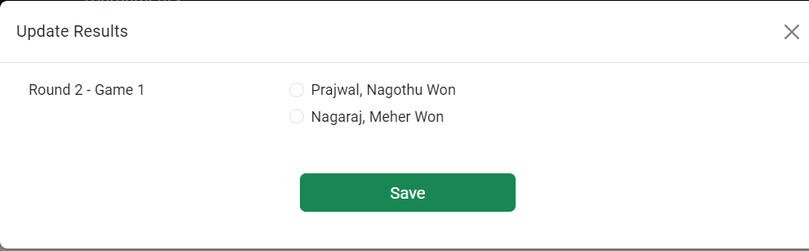
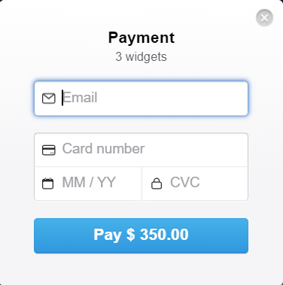
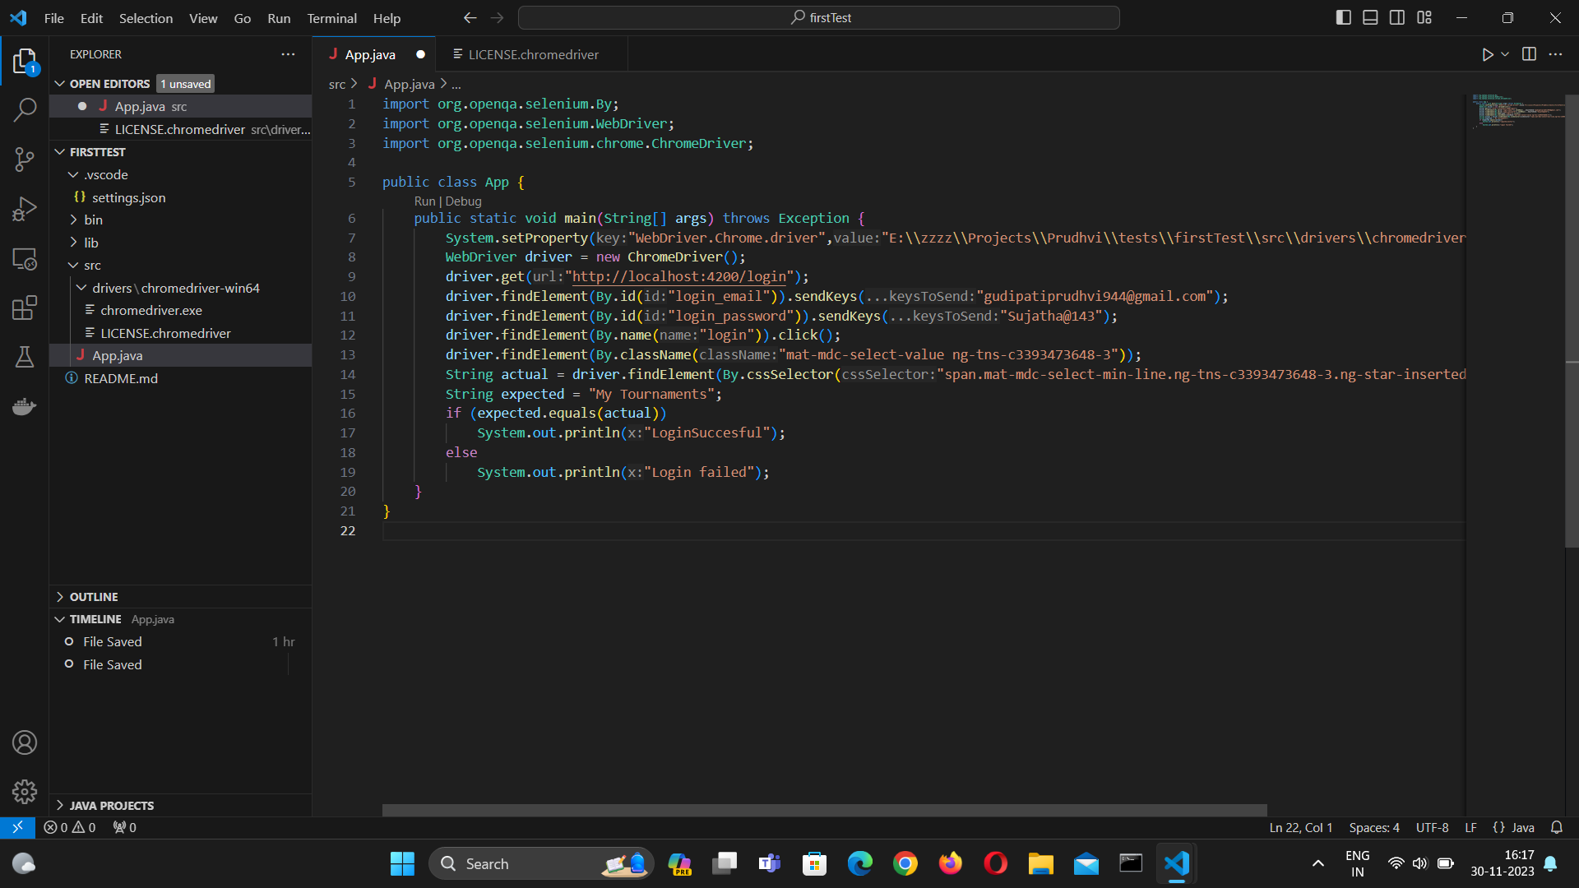
Testing

Slide 12
Maintenance
Data Security
Community Engagement
Analytics and Monitoring
User Support and Feedback

Slide 13
Future Scope
Sponsorship and Advertising Integration
Virtual Reality(VR) Integration
Streaming Platform Integration
Mobile Application
Notifications

Slide 14

DEMO

Slide 15

Questions?

